Slide 1

Diablo 4
Chris DeLaGarza, Ryan King, Ryan Jacobs, Justin Carter

Slide 2
Goal of the game
Progress through the maps fighting and leveling until you reach the final boss and beat him.
Train your weapons and hone your skills as you traverse the maps searching for the next area.
Kill more enemies to collect higher level weapons.

Slide 3
maps
The maps consist of many types of terrain and enemies.
At the end of some maps are Mini Bosses or the Final Boss.
Maps have certain levels that determine enemy levels.
Once you surpass a certain maps level cap, xp drops will default to 1 per enemy and will encourage the player to move on to progress through the game.

Slide 4
Controls
W,A,S,D – movement controls
Q,E(or 1,2,3,4) – Switch through hot slots
TAB – open the backpack
Scroll wheel – move up or down in the backpack
Click Scroll wheel – move left of right in the backpack
Left Click – Fire Weapon or use items
Right Click – Switch backpack item with hotslot selected
F – Place weapon into turret
ESC. – pause the game

Slide 5
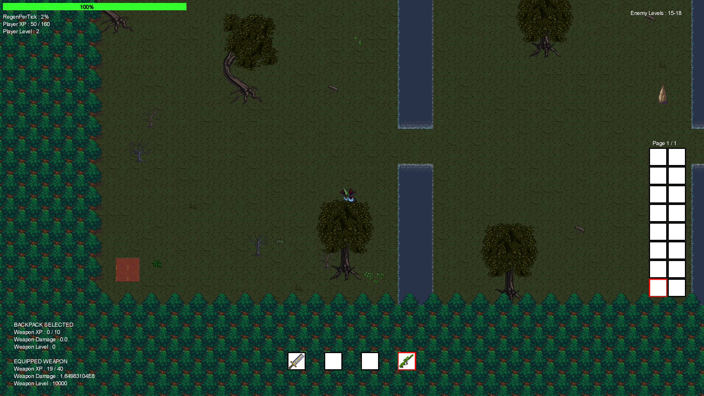
Display the range of enemy
Levels in the maps
Health, regen rate, exp, level
Back Pack
Weapon stats display for the
Hot slot item and the backpack item
Hot Slots 1-4

Slide 6
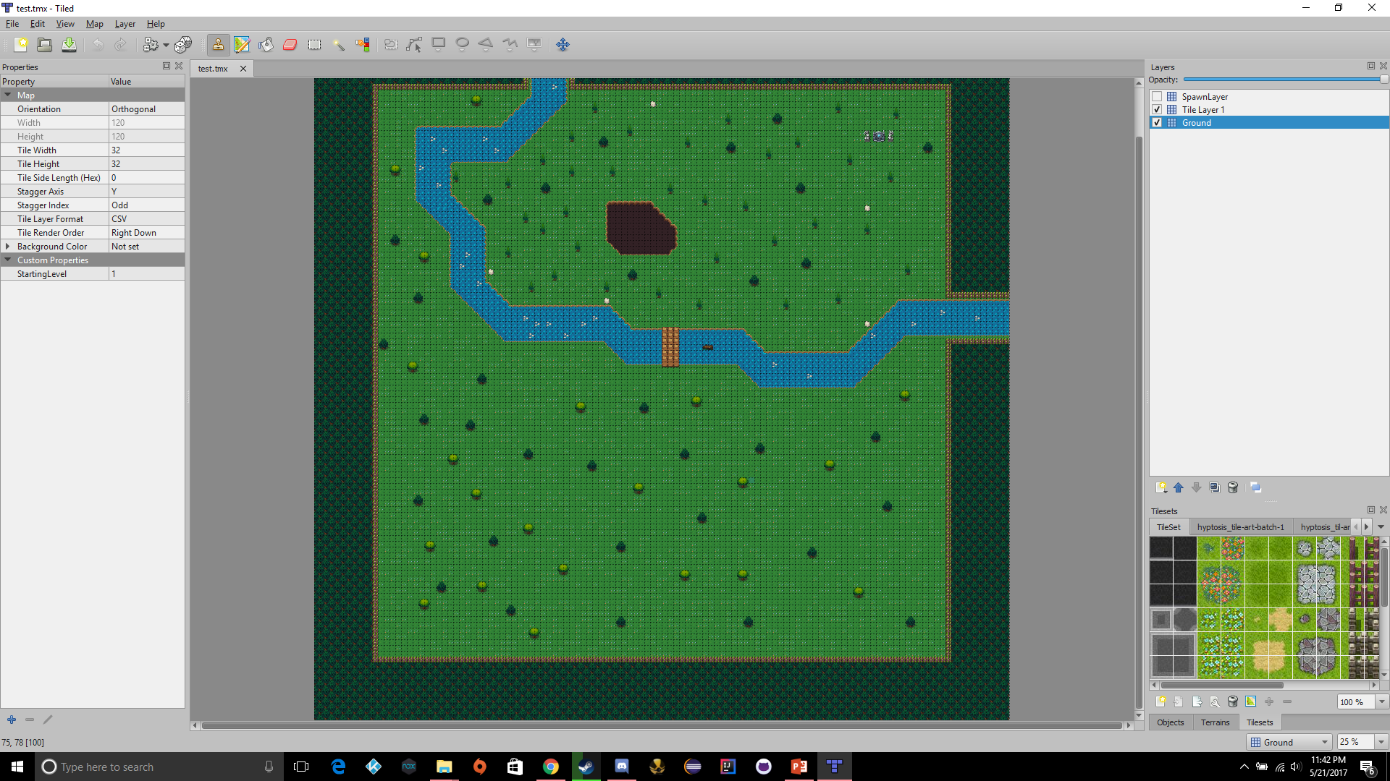

Slide 7
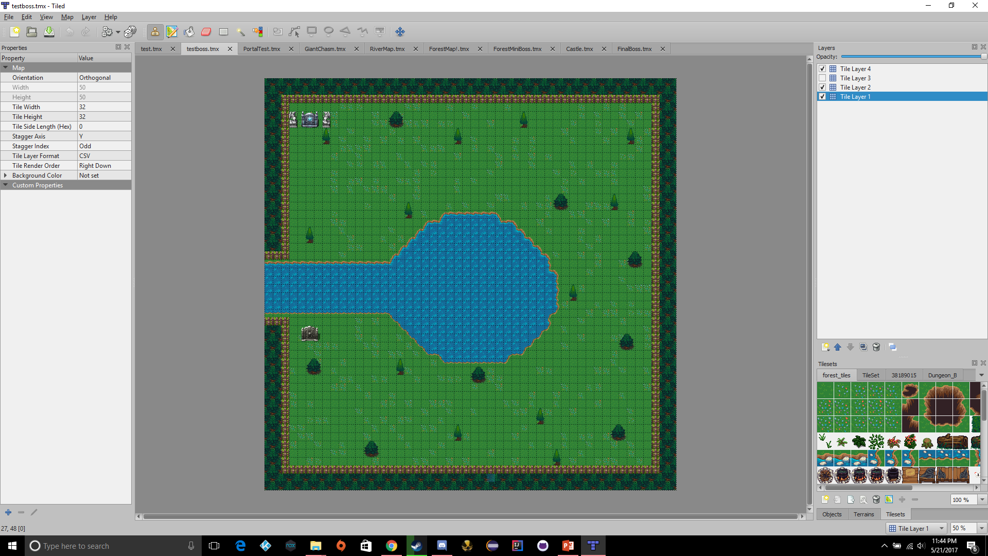

Slide 8
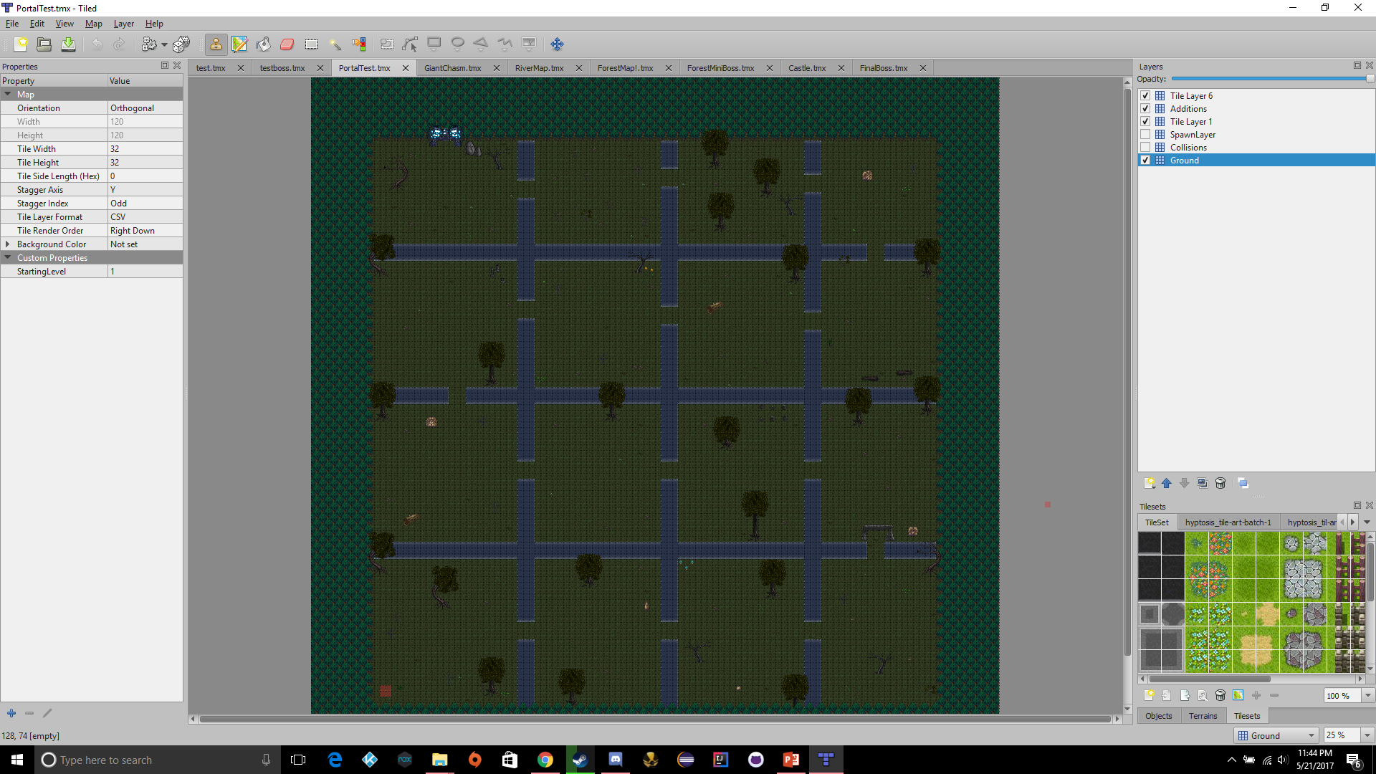

Slide 9
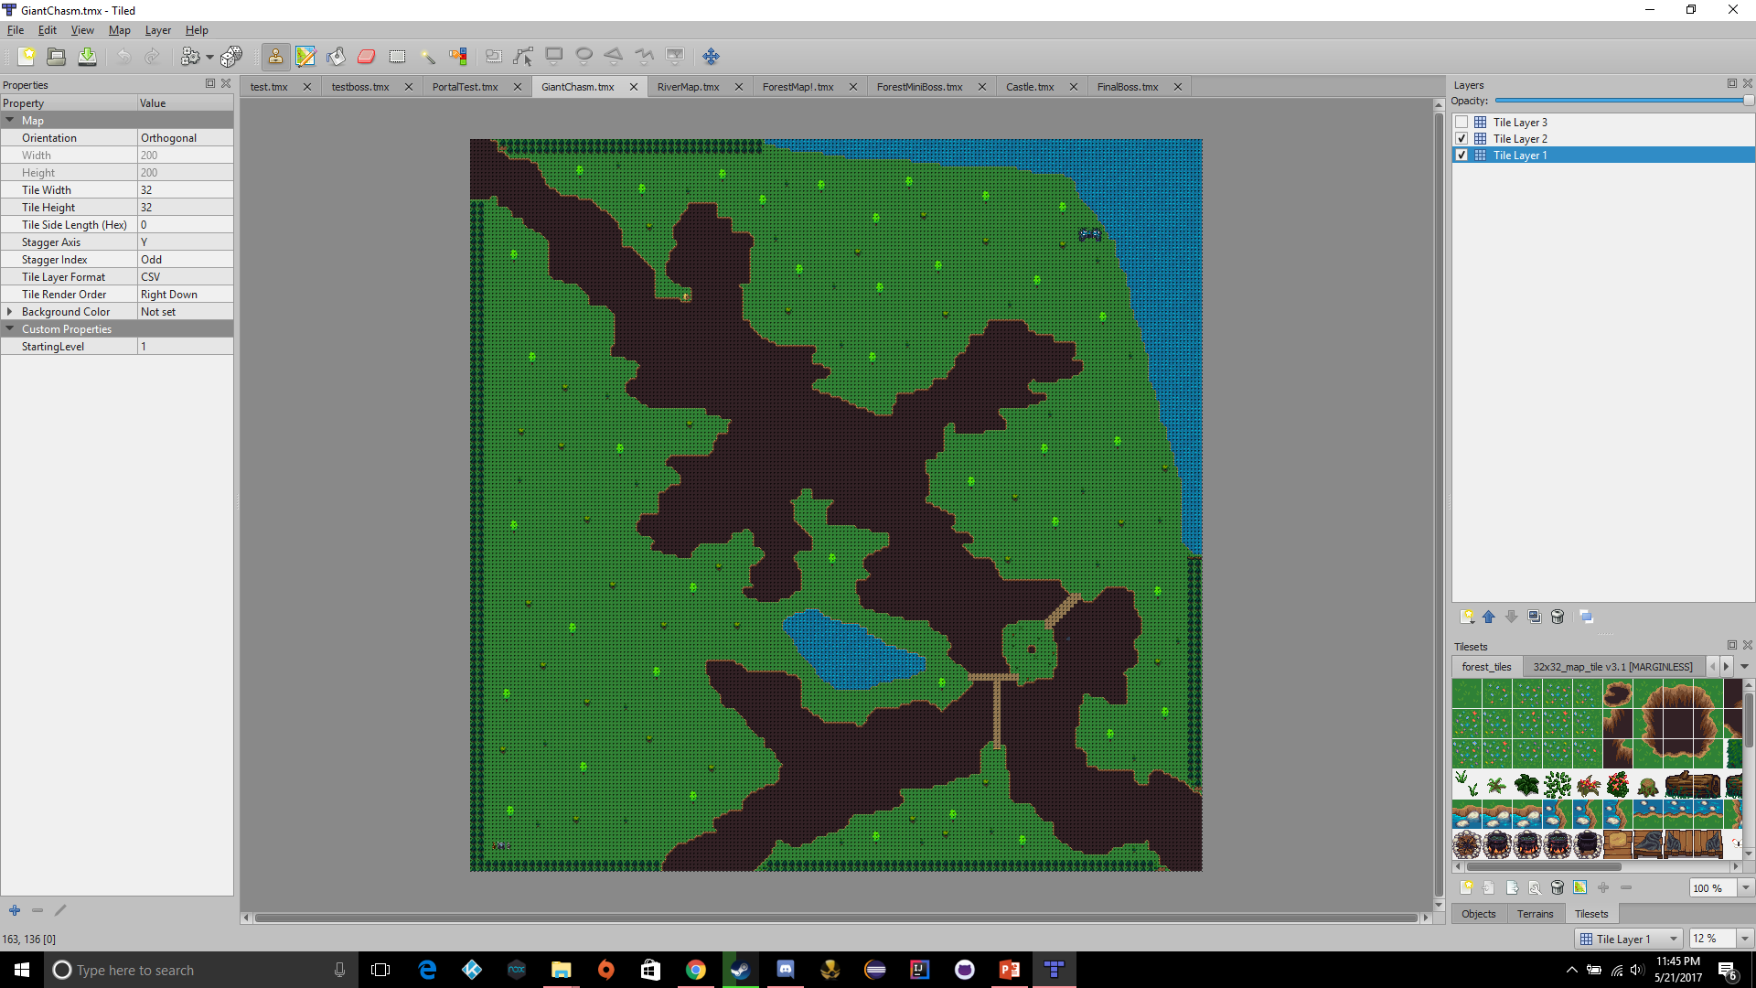

Slide 10
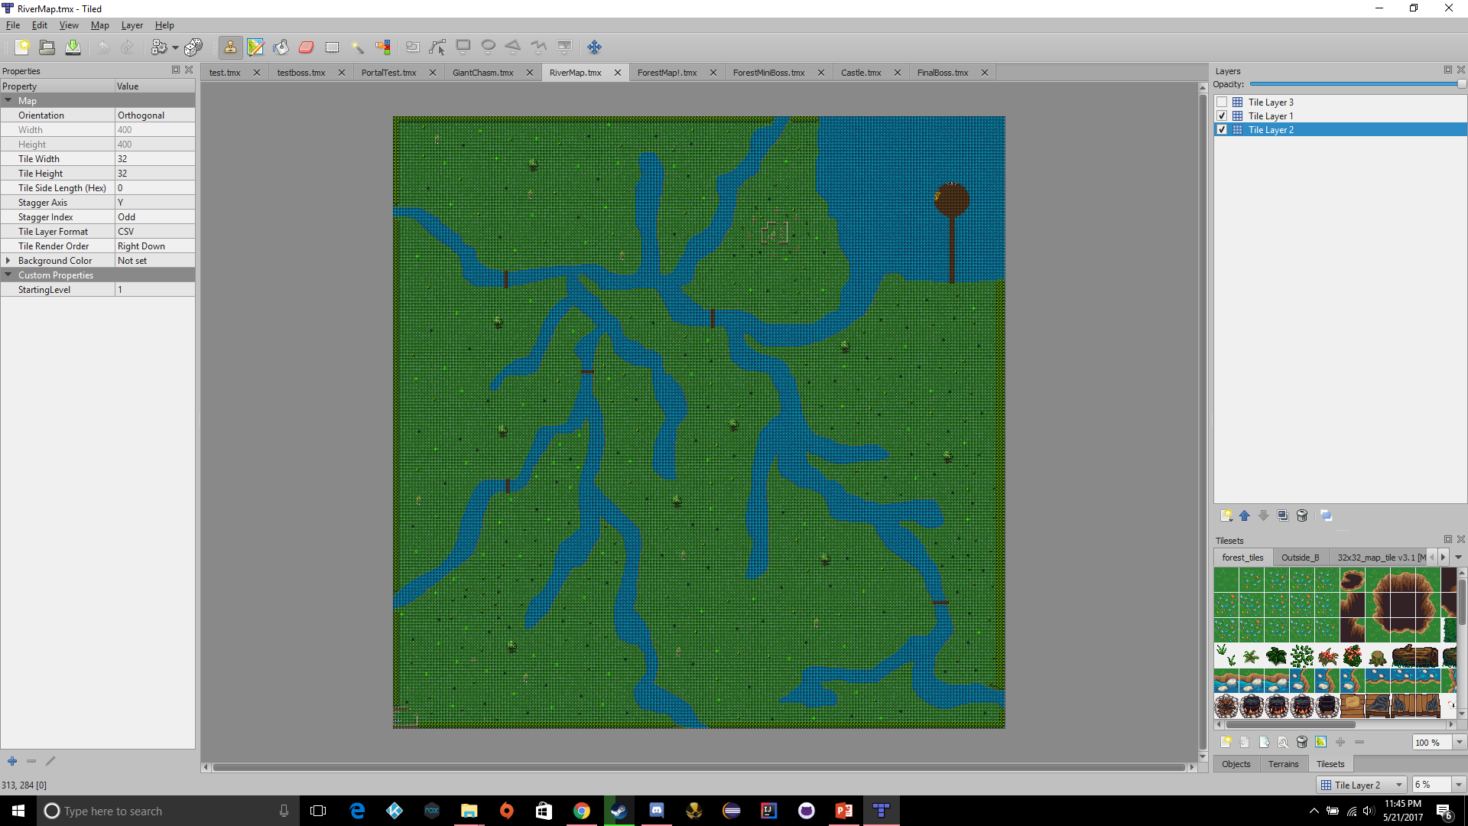

Slide 11
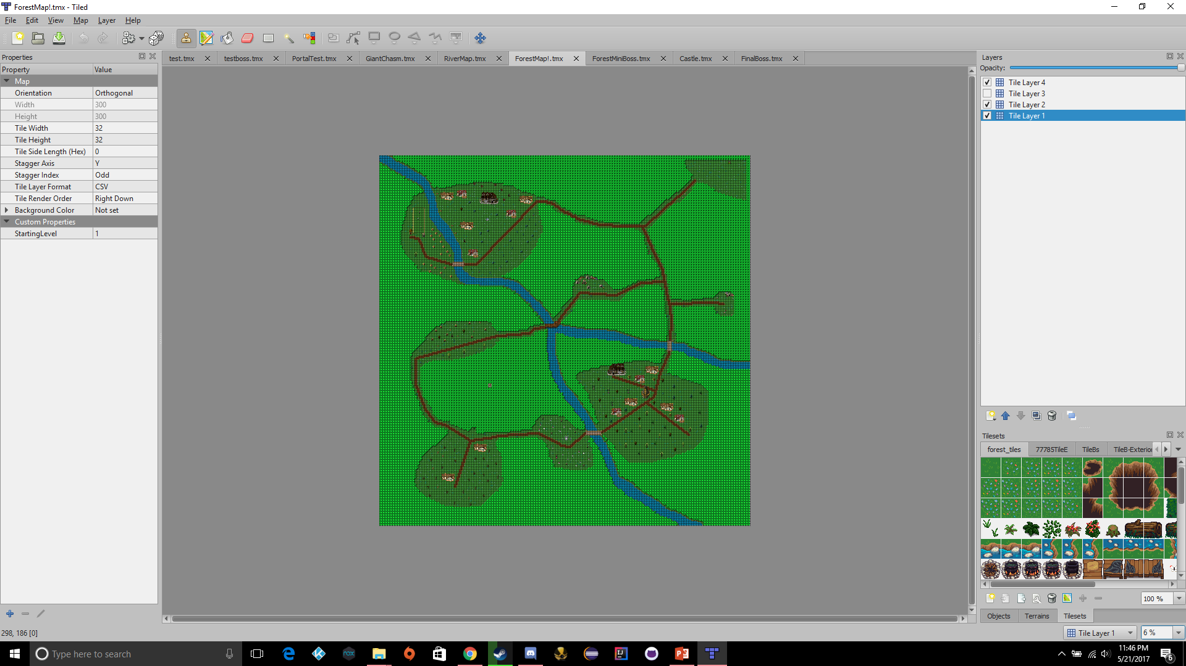

Slide 12
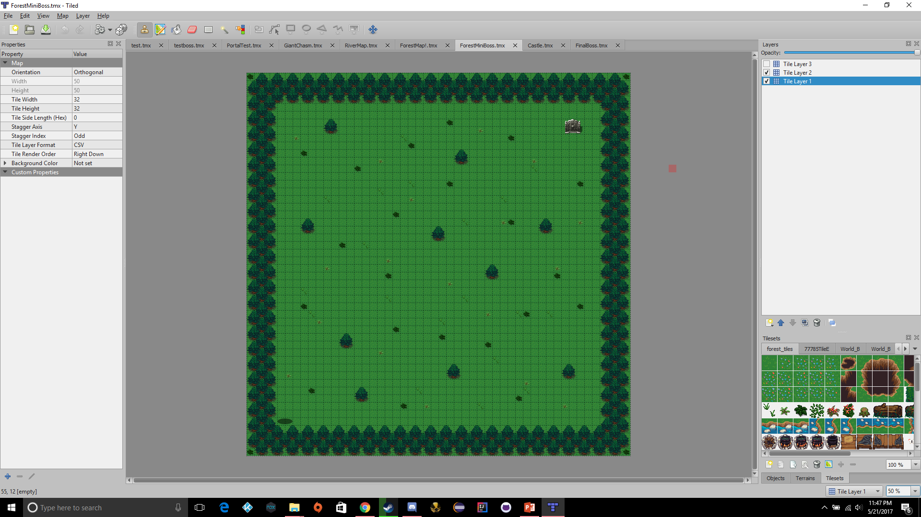

Slide 13
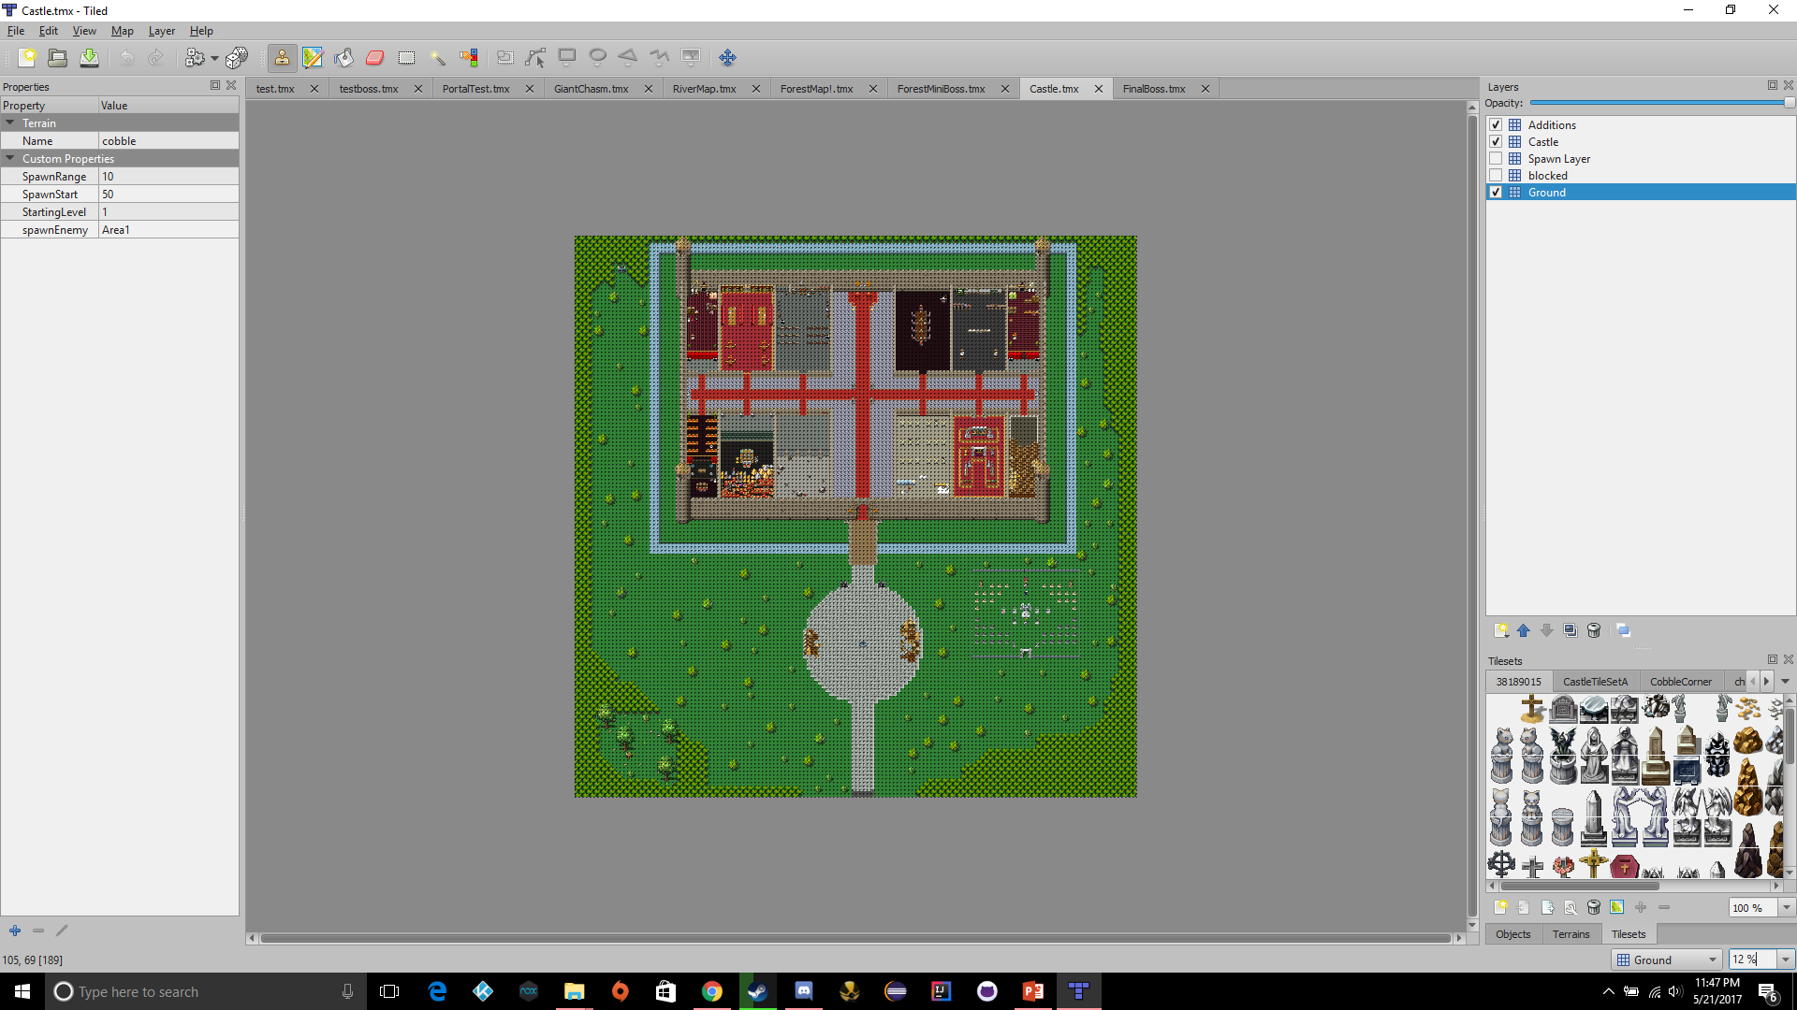

Slide 14
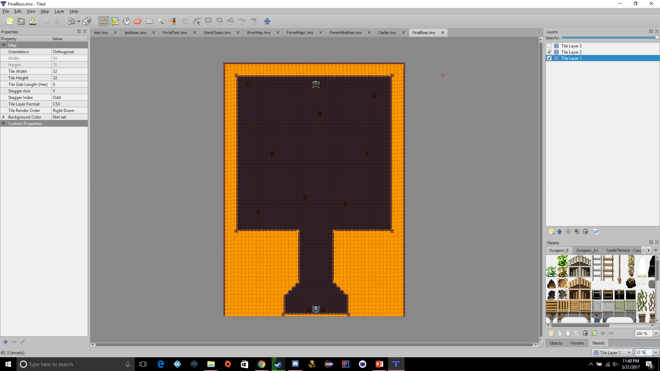

Slide 15
Play the game
Play the game

